Slide 1
Dog Rates
Let’s see my project

Slide 2
WHAT IS THIS
PROJECT?

Slide 3
This project is about
That there is a Twitter account named as “WeRateDogs“ that is about dogs rates and
My goal is to make insights about the data of this account

Slide 4





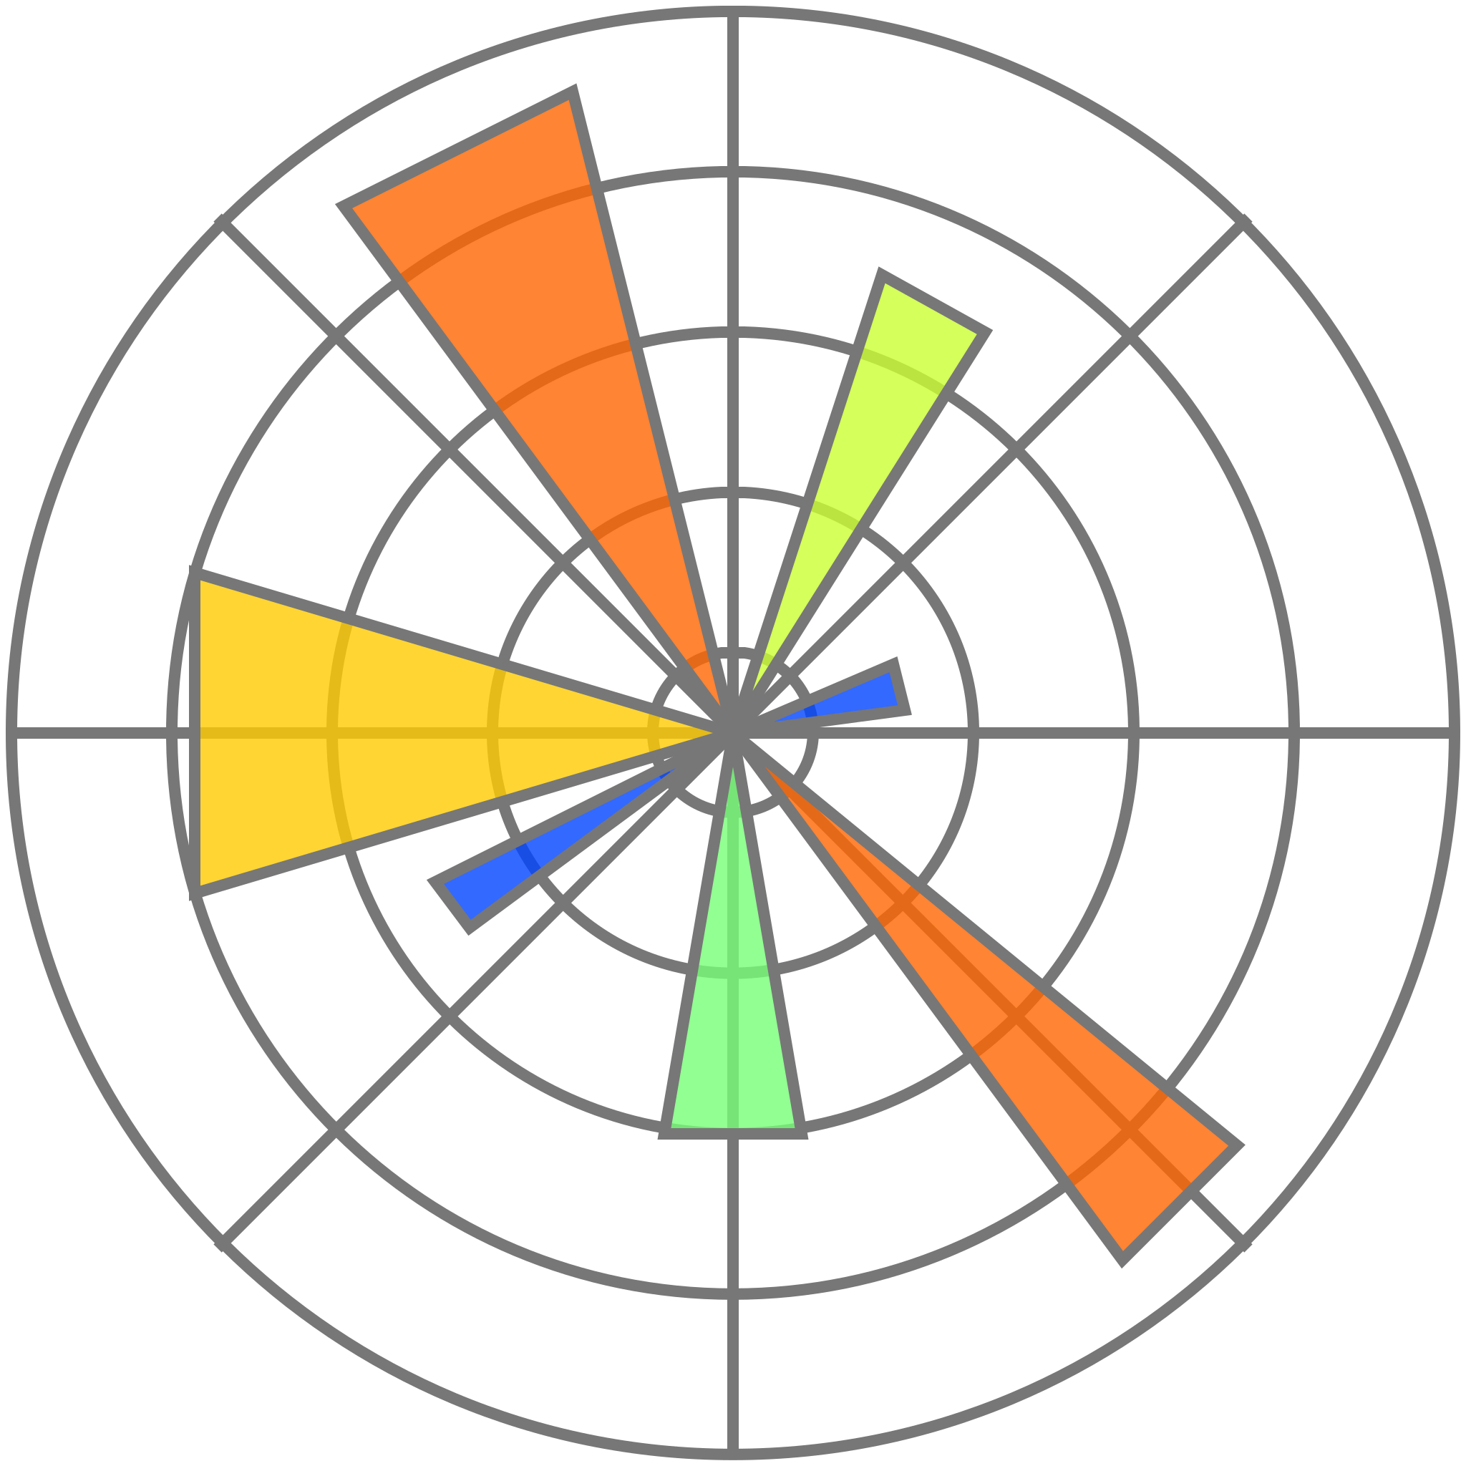
Tools I have used
1: Visual studio code
4: pandas library
2: Python language
2: Numpy library
3: jupyter notebook
3: Matplotlib library

Slide 5
Analysis steps
1
Gathering Data
3
Cleaning Data
2
Investigating Data
4
Investigating Data

Slide 6
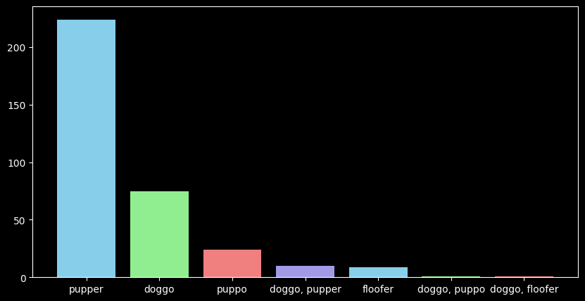
First insight:
The most
common dog
stage is pupper
Regardless the dogs that doesn’t have stages
THIS

Slide 7
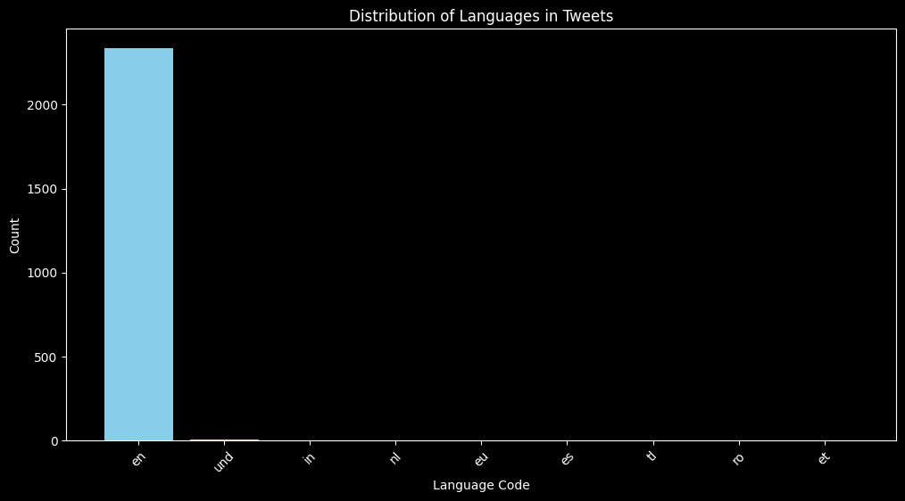
Second insight:
The most
common language
is English
THIS

Slide 8
Thanks for your time
👋

